Slide 1

Welcome to …
CNENGR506
Intelligent System Control

Slide 2

CNENGR506
Intelligent System Control
Contents
Part 1 – Terminology and Objectives of Control
Part 2 – Discrete–Time Transfer Function Models
Part 3 – System Identification
Part 4 – Discrete–Time Control & Pole Assignment
Part 5 – State Variable Feedback
Part 6 – Additional Topics & Case Studies

Slide 3
ENGR406 (506)
Intelligent System Control
Contents
Part 1 – Terminology and Objectives of Control
Part 2 – Discrete–Time Transfer Function Models
Part 3 – System Identification
Part 4 – Discrete–Time Control & Pole Assignment
Part 5 – State Variable Feedback
Part 6 – Additional Topics & Case Studies

Slide 4
Part 1 – Terminology and Objectives of Control
Contents
Section 1.1 – Introduction
Section 1.2 – Syllabus
Section 1.3 – Feedback
Section 1.4 – Control Objectives
Notes:
Introduction
Course content what we cover and what we not:
Open loop basics and Closed loop-Feedback
4 basic control objectives

Slide 5
CNENGR506)
1.1 Introduction

Slide 6
Educational Aims
Introduction to modern algorithmic, computer-aided control system design methods.
Advanced concepts such as digital and optimal control are introduced using algebra and block diagrams.
Addresses the needs of students who would like to advance their knowledge of automatic control, optimisation and data analysis.
Practical worked-examples from robotics, industrial control, environmental systems, among other areas.

Slide 7
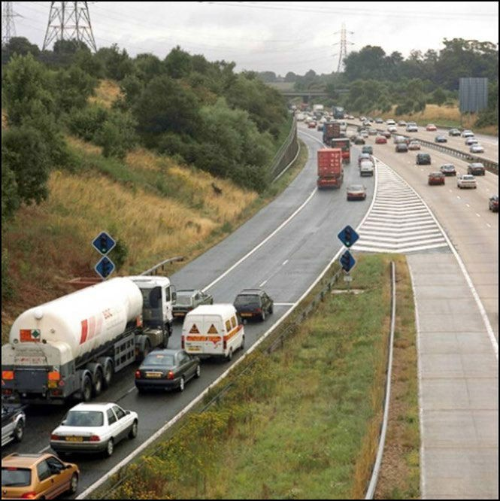
“Control”
Human controls the car, direction and speed
Human also considers wider issues such as safety, fuel, navigation
Automatic control systems include power steering, cruise control, active suspension, etc.
Notes:
Why I put Control on Heading: Its English common word
Lot of control here in this pic
From Human to technology
Human- 3 D control: Input break, accelerator, steering etc: Output: control output: Car speed, Road position: looks like closed loop control responding to environment
Car- may be Automatic Control: power steering,
Traffic light another control system

Slide 8
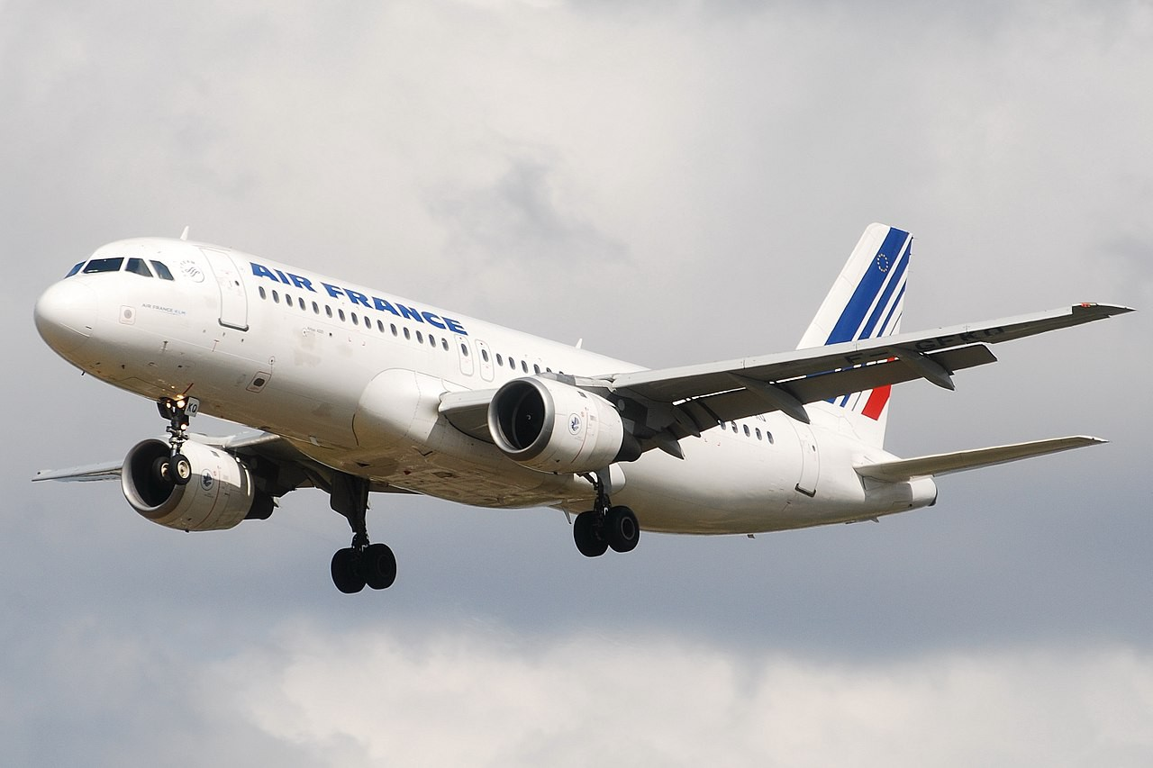
Automatic Control
Multivariable aircraft control systems decouple flight variables such as pitch, velocity, altitude
Optimal controllers ensure the completion of the system objectives and the minimization of a performance index
https://en.wikipedia.org/wiki/Airbus_A320_family#/media/File:Airbus_A 320-100_Air_France_(AFR)_F-GFKQ_-_MSN_002_(10655931213).jpg

Slide 9
Selected Projects
Illustrative fourth year MEng team projects and MSc individual projects…

Slide 10
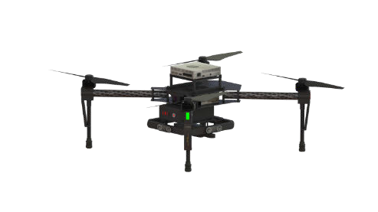
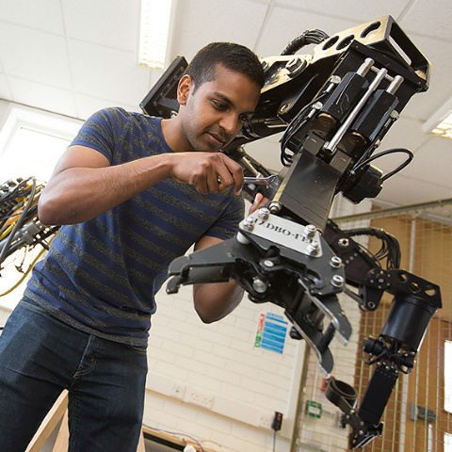
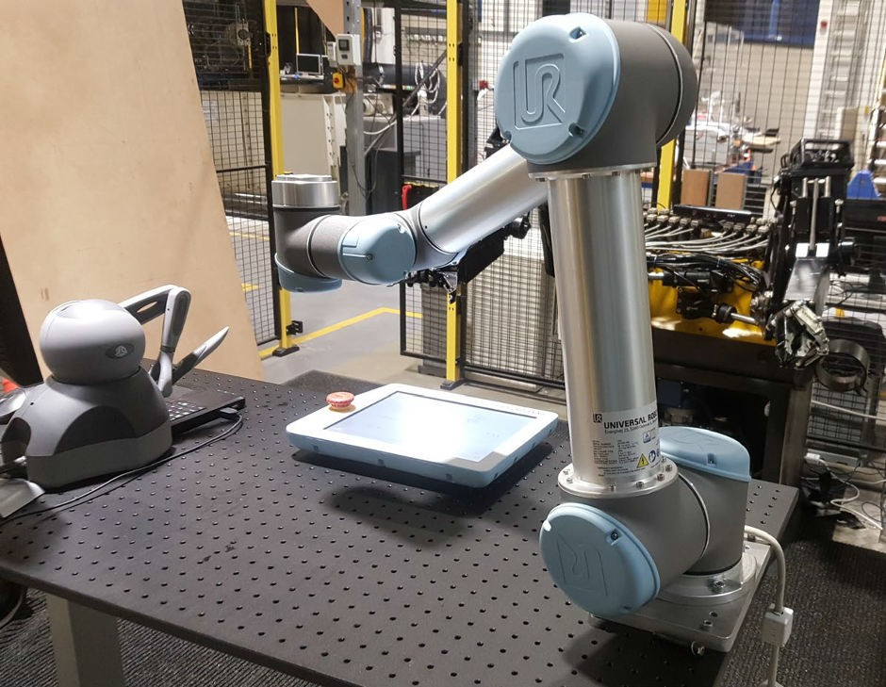
Robotics and Autonomous Systems (RAS)

Slide 11
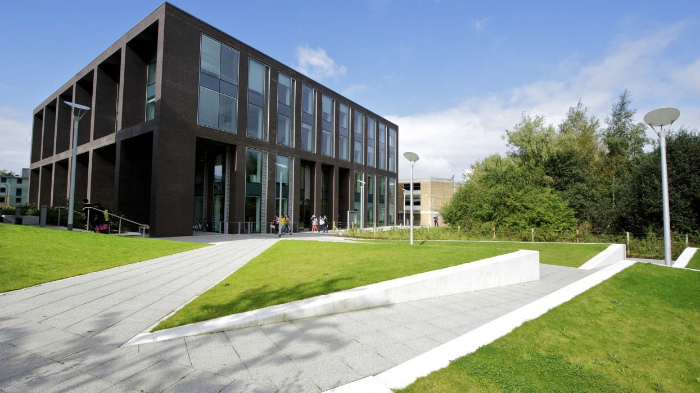
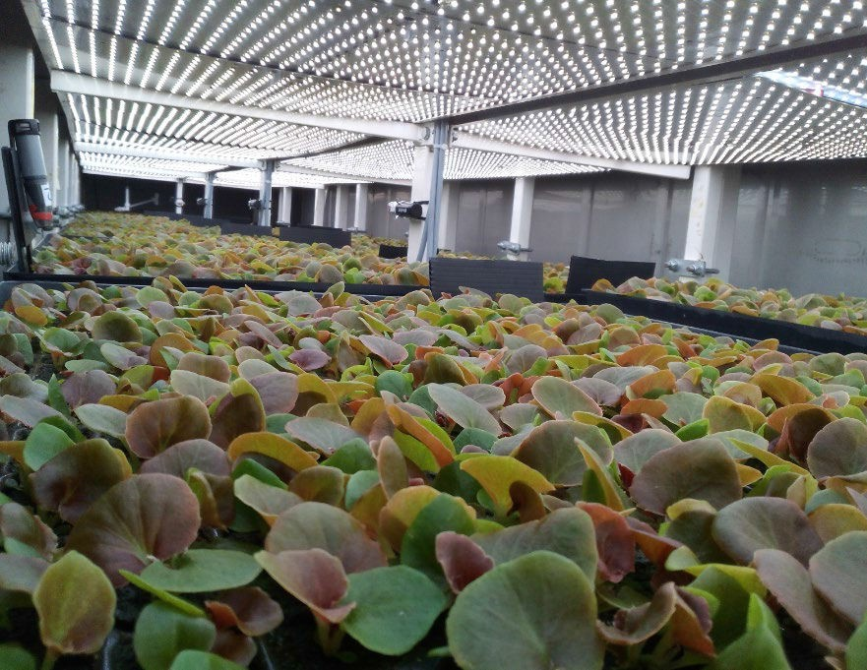
Environmental Control
Optimisation, control of micro–climate and energy management
(Charles Carter Building)
Control of LEDs, temperature and ventilation rate in an enclosed grow–cell

Slide 12
Control Engineering Definition
Control Engineering is the science of changing the dynamical behaviour of physical systems in some desirable way.

Slide 13
Module Scope
Have you been taught these?
Classical control, continuous-time, Laplace Transforms, mechanistic models, frequency domain techniques, root locus, proportional-integral-derivative (PID) control.

Slide 14
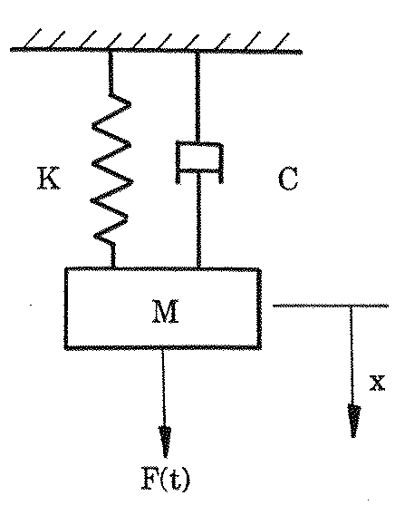
Mass–Spring–Damper
d
2
^{x} + 2ζω
dx _{+ ω}
² x = Ku(t)
dt ²
^{n} dt
n
d
2
^{x} + ^{C dx} + ^{K} x = ¹ F (t)
dt ²
M dt M M
1
X (s) =
F (s)
Ms² + Cs + K
Notes:
1st equation- 2nd order differential equation
2nd: mathematical model
3rd: Laplace Transform

Slide 15
PID Algorithm
de(t)
u(t) = k
e(t) + k
I ∫
e(t) dt + k
p
d
dt

Slide 16
Part 1 – Terminology and Objectives of Control
Contents
Section 1.1 – Introduction
Section 1.2 – Syllabus
Section 1.3 – Feedback
Section 1.4 – Control Objectives
Section 1.5 – Module Details

Slide 17
Module Scope (2)
Have you been taught these?
Classical control, continuous-time, Laplace Transforms, mechanistic models, frequency domain techniques, root locus, proportional-integral-derivative (PID) control.
What about these ?
Modern control methods, discrete-time, data-based (statistical) models, state variable feedback, predictive and optimal control, etc.

Slide 18
Quick History Lesson

Slide 19
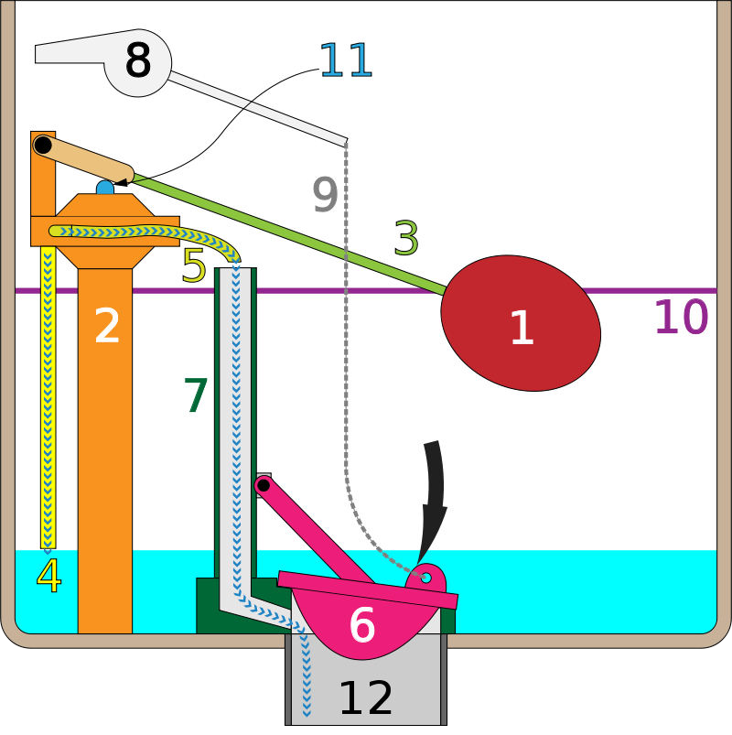
Float Valve
float
fill valve
lift arm
tank fill tube
bowl fill tube
flush valve flapper
overflow tube
flush handle
chain
fill line
fill valve shaft
flush tube
https://en.wikipedia.org/wiki/Ballcock#/media/File:Gravity_t oilet_valves_handle_released.svg

Slide 20
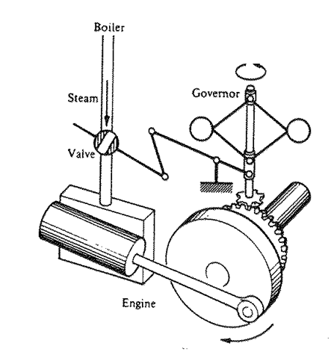
Watt’s Flyball Governor
Invented in 1788 by James Watt to regulate the admission of steam into his steam engine cylinder(s)
James Clerk Maxwell’s famous paper On Governors appeared in 1868
http://rspl.royalsocietypublishing.org/content/16/270

Slide 21
History Lesson Continued
Mechanical controllers (float valve etc.)
Feedback dynamics (Maxwell 1868, Routh 1877 etc.)
Graphical methods based on frequency response (Nyquist 1932, Bode 1940, etc.)
Industrial process control using PID methods
… Classical Control
Numerical solution of differential equations using digital computers
R.E. Kalman (1960s), state space, moon landings
… Modern Control

Slide 22
Classical Control
Usually PI or PID control structure
Control parameters tuned using Rules of Thumb
Bode Plots, Nyquist Diagrams etc.
Design usually based on continuous-time techniques, with the controller digitised to operate on a modern computer
Advantages: familiar to industry
Why change something that works?

Slide 23
Modern Control
Many types of controller structure
Control gains determined on the basis of a model
e.g. model-predictive control (MPC)
Advantages: improved performance, can be optimised to meet multiple objectives, adaptive control, multivariable decoupling, etc.

Slide 24
Syllabus
System Identification
Concept of Feedback, Terminology and Objectives of Control
Optimal control
Introduction to “Modern Control” Theory
State variable feedback using non-minimal state space models
Robust control
Transfer Functions represented using the
Backward Shift operator
Stochastic control
Feed-forward control
Block diagram analysis, pole assignment and discrete-time PI control
CORE TOPIC
Multivariable & Non-linear

Slide 25






Timetable
3
System
Identification
Concept of Feedback, Terminology and Objectives of Control
1
2
Optimal control
Introduction to “Modern Control”
Robust control
6
Transfer Functions represented using the
Theory
5
Backward Shift operator
State variable
Stochastic control
feedback using non-minimal state space models
pole assignment and 4
Block diagram analysis,
discrete-time PI control
Feed-forward control
CORE TOPIC
Multivariable & Non-linear

Slide 26
Short Exercise…
Are the objectives clear?
What do you hope to learn from this module?
What do you expect to be the most challenging part?

Slide 27
ENGR506
1.3 Feedback

Slide 28
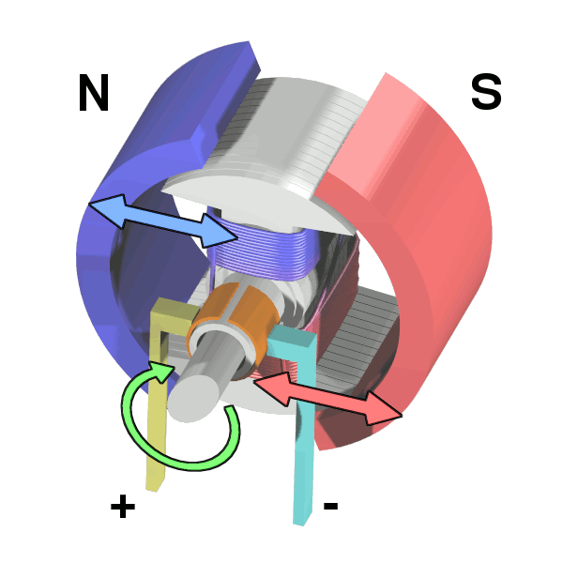
Case Study
A common actuator is a DC motor which provides direct rotary motion or, via drums and cables, translational motion
For the purposes of this example, there is an applied Input voltage U and a shaft speed Output X
This U and X notation is used throughout the module (either X or Y is used for the output)
https://en.wikipedia.org/wiki/DC_motor#
/media/File:Electric_motor_cycle_2.png

Slide 29
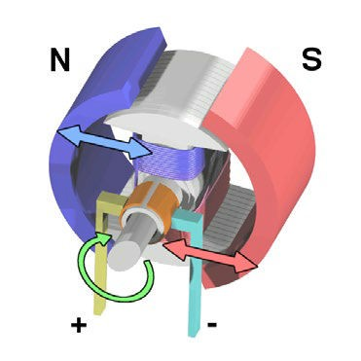
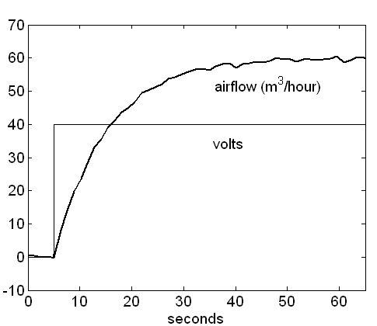
Step Response
Input Signal
Actual Motor Speed (Volts)
(Volts)
U
X
motor speed
Plant
input signal

Slide 30

Open–Loop Control
Desired Motor Speed (Volts)
Input Signal (Volts)
Actual Motor Speed (Volts)
D
U
X
Controller
Plant

Slide 31
Proportional Control (Open–Loop form)
Input Signal (Volts)
Desired Motor Speed (Volts)
D
Actual Motor Speed (Volts)
U
X
K _{p}
Controller
Plant
U = K_{p} × D
(Control Algorithm)
Select control algorithm (here, Proportional)
Optimise or “tune” algorithm (here, numerical value of K_{p})

Slide 32
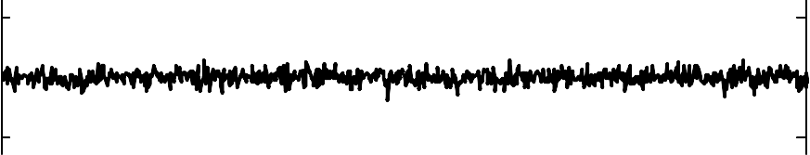
Open–Loop Control of a DC Motor (Zero Disturbances)
22
20
18
Output
200
400
600
800
1
0.5
0
Control Input
200
400
600
800
0.05
0
-0.05
Disturbance (zero)
200
400
600
samples
800
Kp?
Notes:
What is Value of Kp?

Slide 33
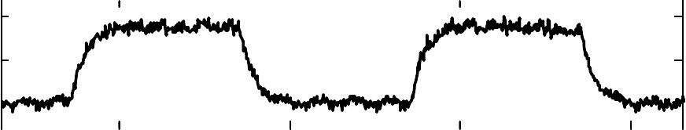
Open–Loop Control of a DC Motor (Square Disturbances)
25
20
15
Output
200
400
600
800
1
Control Input 0.5
0
200
400
600
800
0.05
0
Disturbance
-0.05
200
400
sample
600
800

Slide 34
Closed–Loop Control of a DC Motor (Feedback Loop)
Desired Motor Speed (Volts)
Input Signal (Volts)
Actual Motor Speed (Volts)
D
+
U
X
K _{p}
Controller
Plant
For a DC motor, output X is measured with a tachometer, usually a small permanent–magnet that returns a voltage proportional to shaft speed

Slide 35
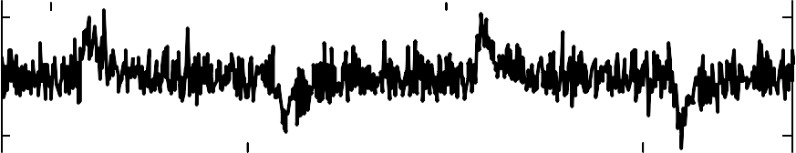
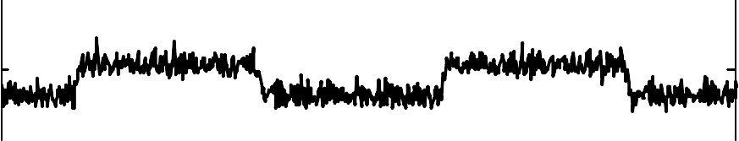
Closed–Loop Control of a DC Motor (Disturbances)
22
20
18
Output
200
400
600
800
1
0.5
0
Control Input
200
400
600
800
0.05
0
-0.05
Disturbance
200
400
600
samples
800
(Results above are for “Integral” control: see later)

Slide 36
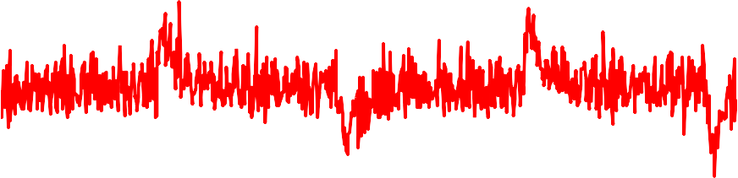
Comparison of Open and Closed–Loop Control
26
24
Open–loop
22
20
18
16
Closed–loop
14
12
200
400
sample
600
800

Slide 37
Advantages of Feedback
Improved transient response
Decreased sensitivity to modelling errors
Decreased sensitivity to disturbances
Ability to eliminate steady state errors
(with inclusion of suitable control elements)
Stabilisation of an unstable system

Slide 38
Closed–Loop Control of a DC Motor (Analysis & Design)
Input Signal
Desired Motor Speed (Volts)
D
(Volts)
Actual Motor Speed (Volts)
U
X
K _{p}
G
+
Controller
Plant
Mathematical analysis using a model to help optimise the control design

Slide 39
Closed–Loop Control of a DC
Motor (Implementation)
Input Signal (Volts)
Desired Motor Speed (Volts)
D
Actual Motor Speed (Volts)
U
X
K _{p}
+
Controller
Plant
Implementation of the optimised
control algorithm on the real system

Slide 40
Closed–Loop Control
(Key Terminology)
r
y_{d}
Desired output
U
X or Y
Output(s)
response
D
Controller System
Control input(s)
System, also commonly called the plant or the process
Desired output response, also called the set point, the command input or the reference level
Controller attempts to adjust the control input to
minimise the difference between the measured output and the desired output (plus other control objectives)

Slide 41
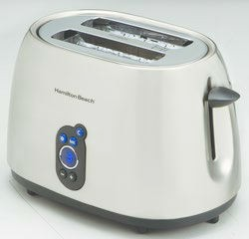
Short Exercise…
Would you describe the control system for a kitchen toaster as open or closed–loop?
Solution – in a moment (audio)
More Examples?
https://en.wikipedia.org/wiki/Toaster#/media/File:Con sumer_Reports_-_Hamilton_Beach_Digital_toaster.tiff

Slide 42
Open Loop Control Systems
Washing Machine
Electric Bulb
Electric Hand Drier
Time based Bread Toaster
Automatic Water Faucet
TV Remote Control
Electric Clothes Drier
Shades or Blinds on a window
Stepper Motor or Servo Motor
Inkjet Printers
Door Lock System
Traffic Control System

Slide 43
CNENGR506
1.4 Control Objectives

Slide 44
Closed–Loop Control (Recap)
r
y_{d}
Desired output
U
X or Y
Output(s)
response
D
Control input(s)
Controller
System

Slide 45
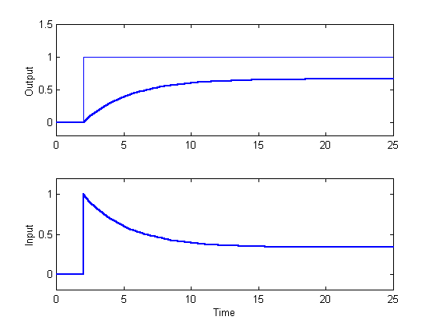
Proportional Control (Feedback Form)
y_{d}
Y
U

Slide 46
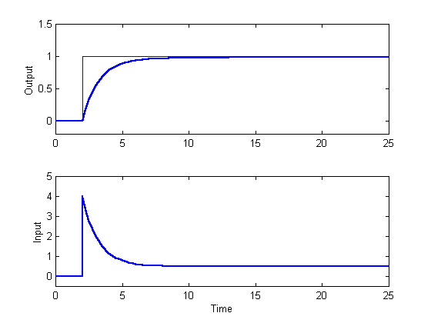
Integral Control (Smooth)
y_{d}
Y
U

Slide 47
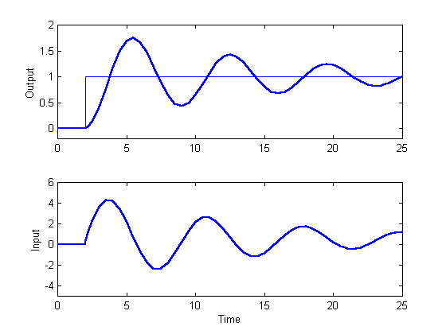
Integral Control (Oscillatory)
y_{d}
Y
U

Slide 48
Four Standard Objectives
The closed–loop system should be stable
The output should track the desired output response in the steady state i.e. there should be no steady state error
The transient behaviour of the system should be
Y
satisfactory
The control
y
d
system should reject disturbances
U

Slide 49
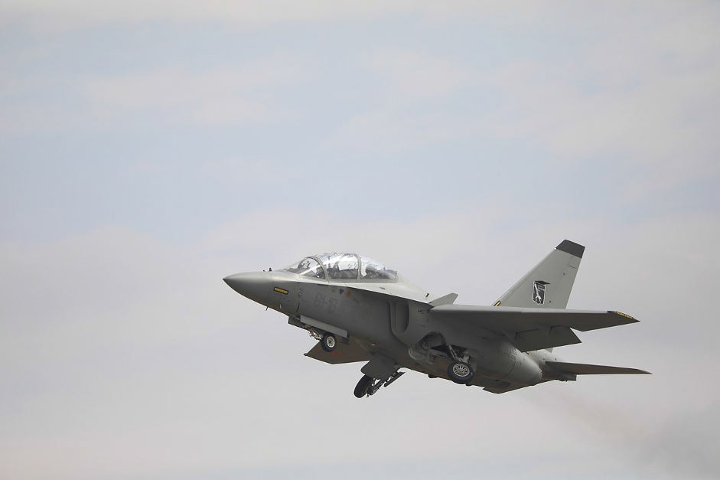

Commercial Aircraft
https://en.wikipedia.org/wiki/Military_aircraft#/media/F ile:Aermacchi_T-346A_5D4_1066_(43074148234).jpg
What is “satisfactory” transient behaviour? What about … safety, operating costs, robustness, etc. And who decides the set point?
More Examples in Tutorial

Slide 50
Assignment-Homework
Choose any one area (some are given below) and provide an example to Appy Four objectives of the Closed Loop Control systems.
Industrial Manufacturing
Robotics
Agriculture
Aerospace
Traffic Management
Telecommunications etc……

Slide 51
Conclusions
Introduction
Syllabus
Feedback
Control Objectives

